Slide 1
Learning Spring Boot 2020/12/10

Slide 2
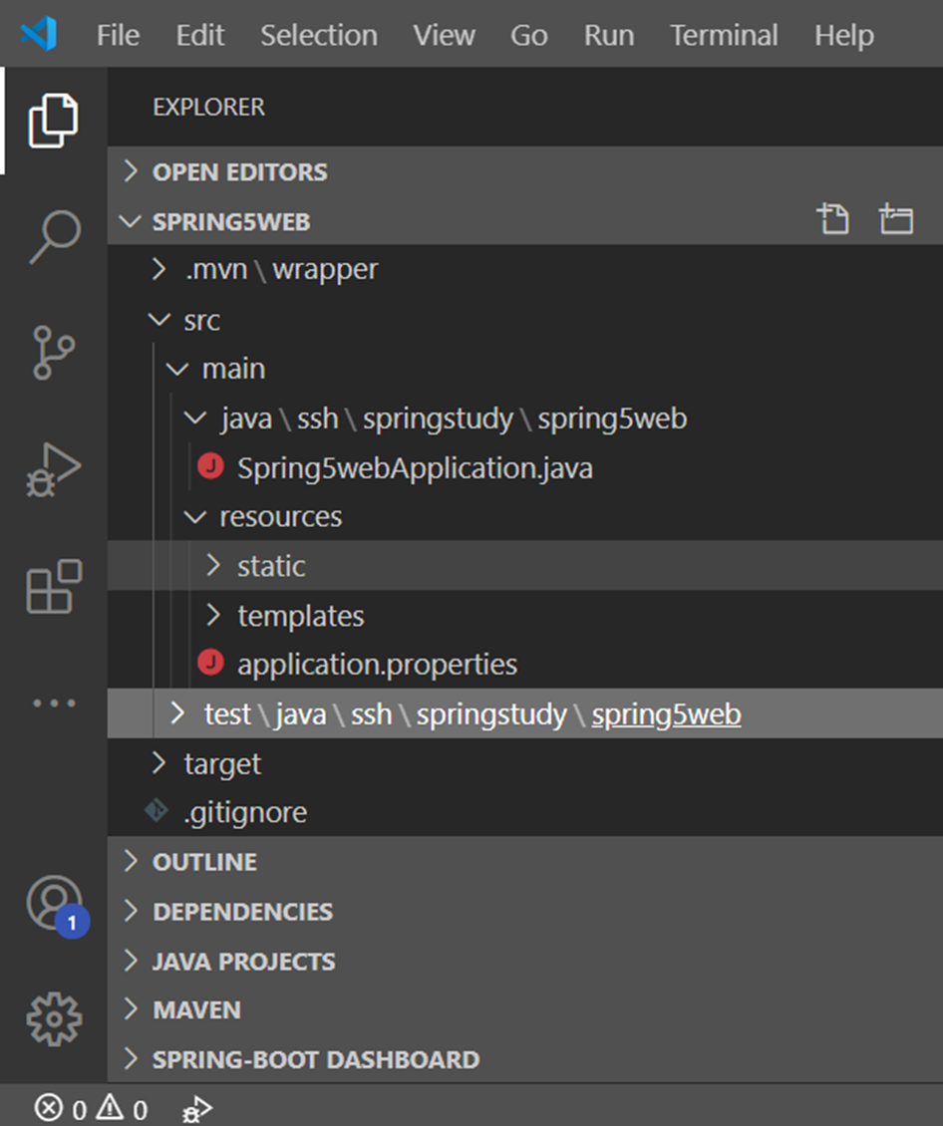
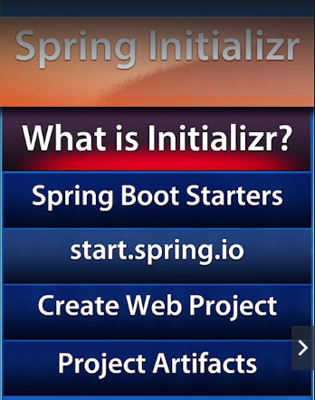
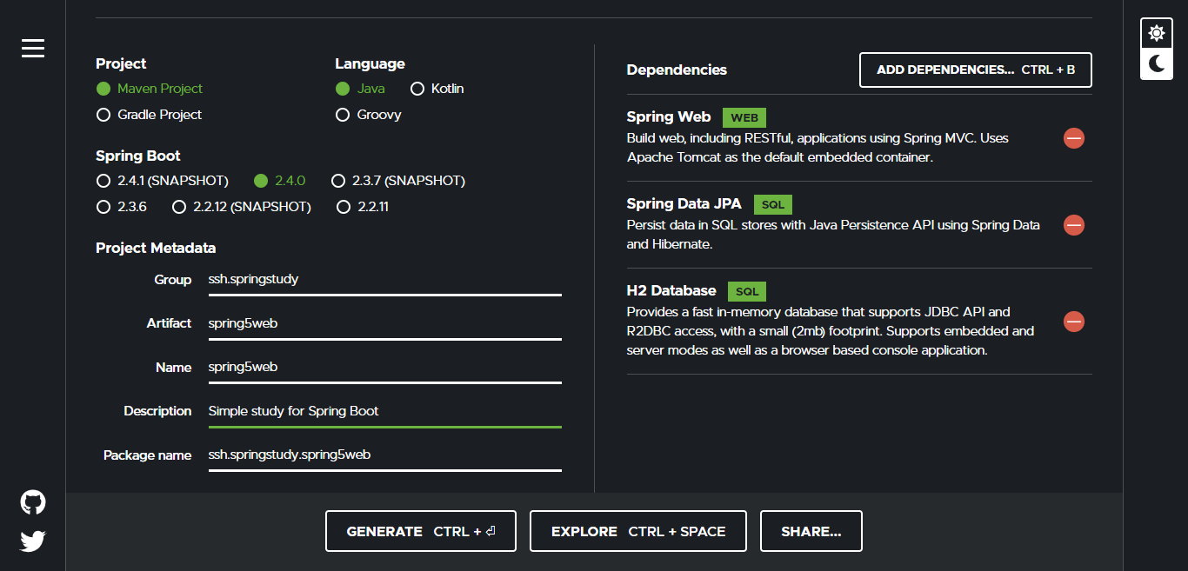
Spring Initializr
https://github.com/spring-io/initializr
Spring Boot Starters
https://github.com/spring-projects/spring-boot/tree/master/spring-boot-project/spring-boot-starters
Start.spring.io
Create spring project with online as in follows website:
https://start.spring.io/
Create Web Project
Choose follow three dependencies
Spring Web
Spring Data JPA
H2 Database
Generate zip file from the website
Extract zip and Open with VS Code
Project Artifacts
Project Structure as picture

Slide 3
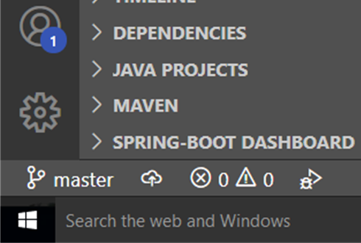
Github WorkFlow
Clone master code
Clone master code
git clone masterrepolink
Git new branch creating
create new branch from master in local evn
git branch shwe-sin-dev
checkout new branch from mastet to shwe-sin-dev
git checkout shwe-sin-dev
pull from remote origin/master
git pull origin master
Push code from master to own branch
git push origin shwe-sin-dev
** You will see new branch in git hub.
Normal Working Flow
Always check your branch in local ( You r now in your branch or not)
git branch
like below image
Develop in your own branch
Commit your change in local evn according to
git commit rule
After commit, pull from remote origin/master
git pull origin master
Push your code to your own branch
git push origin shwe-sin-dev
Make merge request in git lab from your own branch to master

Slide 4
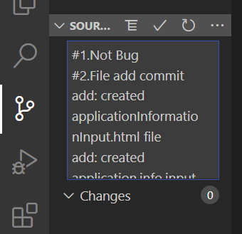
Git commit rule
#1. Bug Fix commit
fix: correct for loop to while loop
[bugitem-23]
#2. Feature added commit
feat: user authentication feature added with spring security library
#3. Refactro code
ref: format code and refactor some code in xyz.py
#4. Comment added commit
docs: java docs added on example method
#5. User interface added commit
ui: remove button in user add xyz page
1.Commit
fix:
Commit:
1.Not Bug
2.Feature added commit
feat: Project Structure Rebuilding
3.Refactro code
#1.Not Bug
#2.File add commit
add: created applicationInformationInput.html file
add: created application.info.input.js file

Slide 5
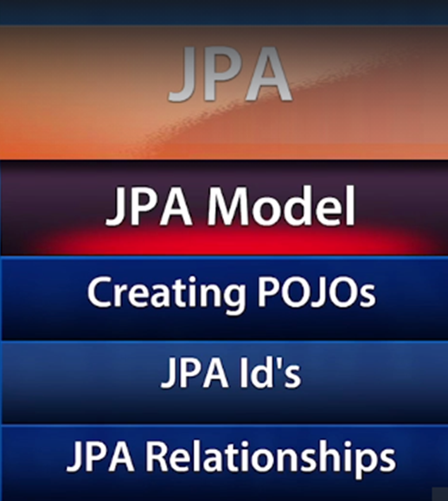
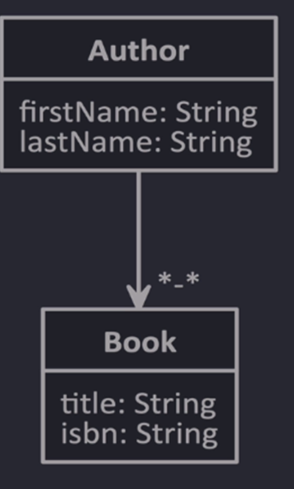
JPA Entities
Plain old Java object (POJO)
Create package
domain
Create classes within domain package
Author
Book
Declare fields in related classes
Create Constructor in Author Class with all fields
Create default/zero argument Constructor in Author Class with no fields for JPA
Create Getter/Setter in Author Class
Do same actions in Book Class as Author Class
Declare fields
Create default/zero argument constructor with no fields
Create constructor with all fields
Create Getter/Setter with all fields

Slide 6
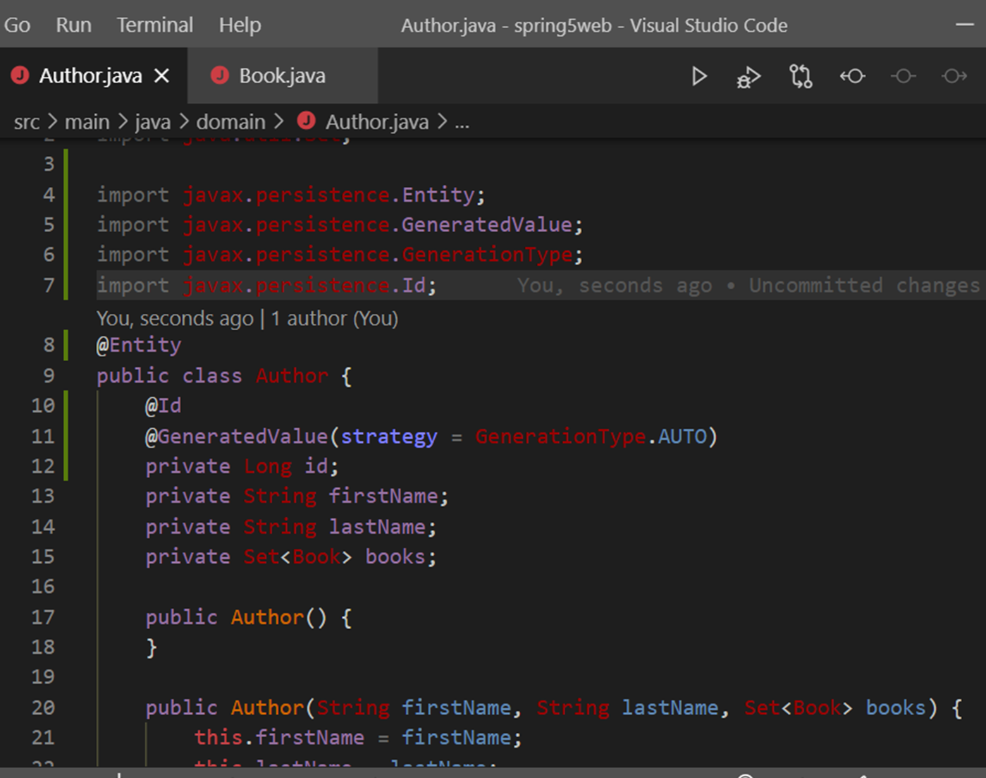
JPA ‘s Id
@Entity declare above Class
Declare primary key for JPA - private Long id;
@GeneratedValue(strategy = GenerationType.AUTO)
Generate Getter/Setter for id
Make as above in Author.java and Book.java classes

Slide 7
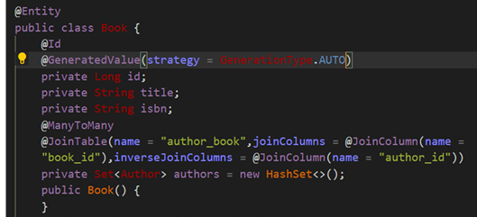
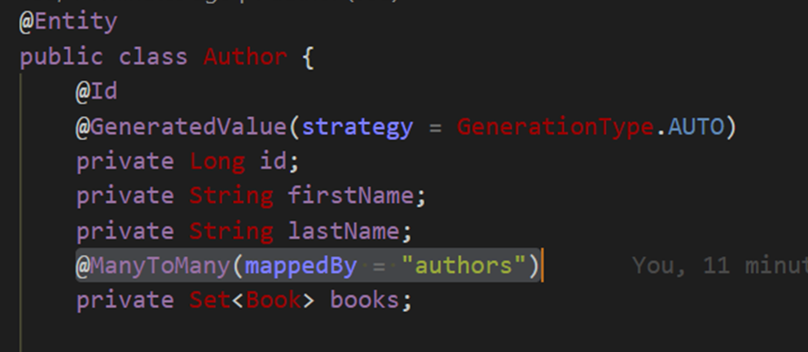
JPA Relationship
Author to Book is many to many relationship
Declare
@ManyToMany(mappedBy = "authors") in Author.java
Declare
@ManyToMany
@JoinTable(name = "author_book",joinColumns = @JoinColumn(name = "book_id"),inverseJoinColumns = @JoinColumn(name = "author_id")) in Book.java

Slide 8
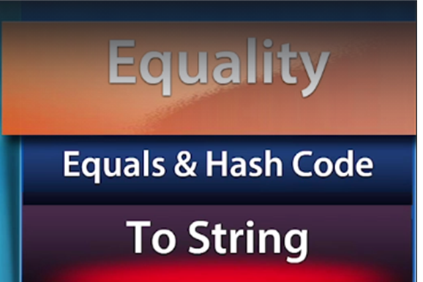
Equality In Hibernate
Make the following two steps in Author.java and Book.java classes
Generate toString () method with all fields
Generate equals() and hashCode() method with id field

Slide 9
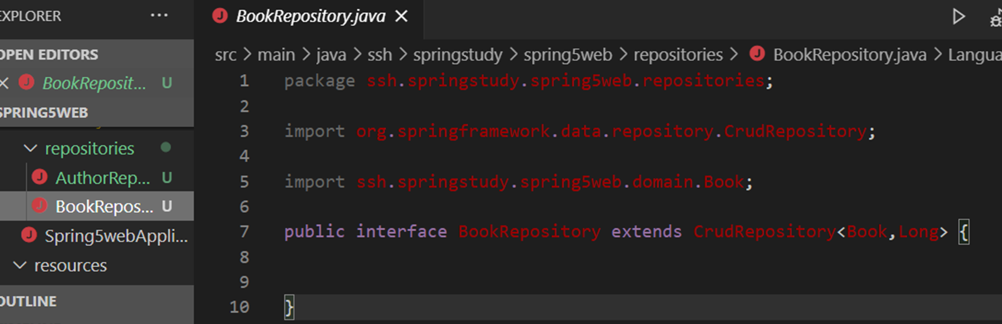
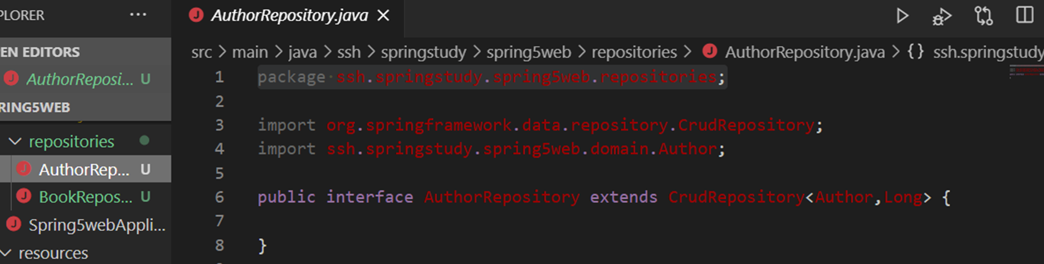
Spring Data Repositories
Create new package named ssh.springstudy.spring5web.repositories
Create BookRepository interface under ssh.springstudy.spring5web.repositories
Create AuthorRepository interface under ssh.springstudy.spring5web.repositories
Entity Class Name
Primary Key Data Type

Slide 10
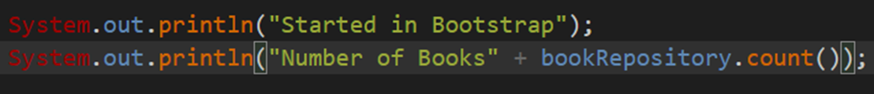
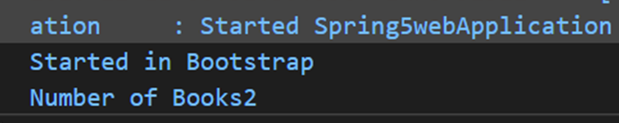
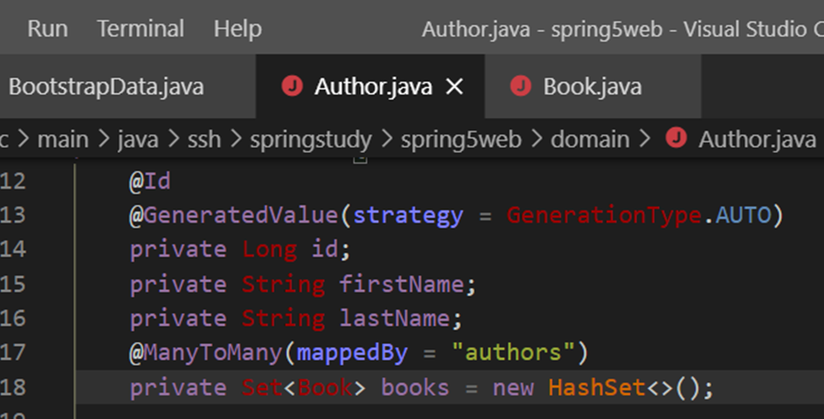
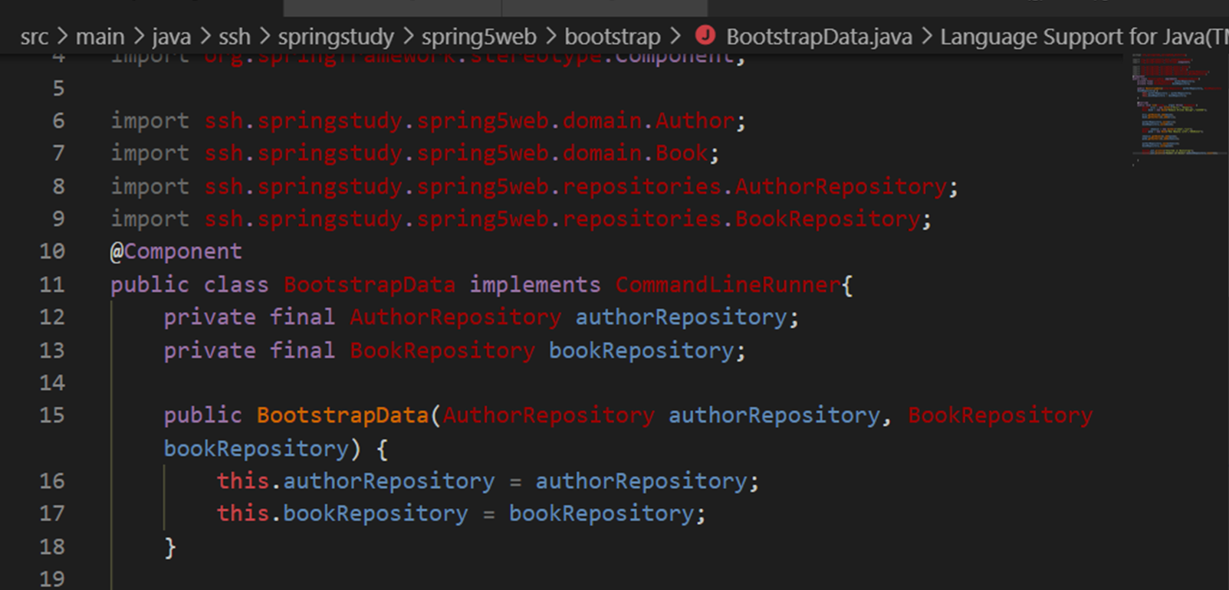
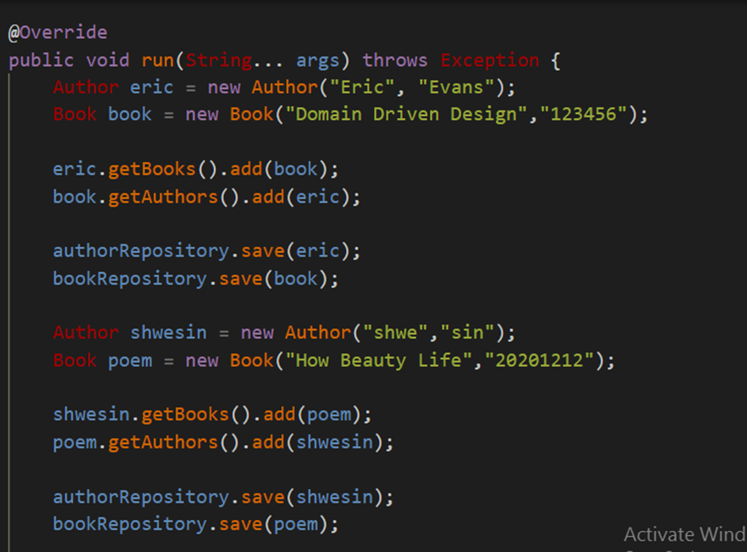
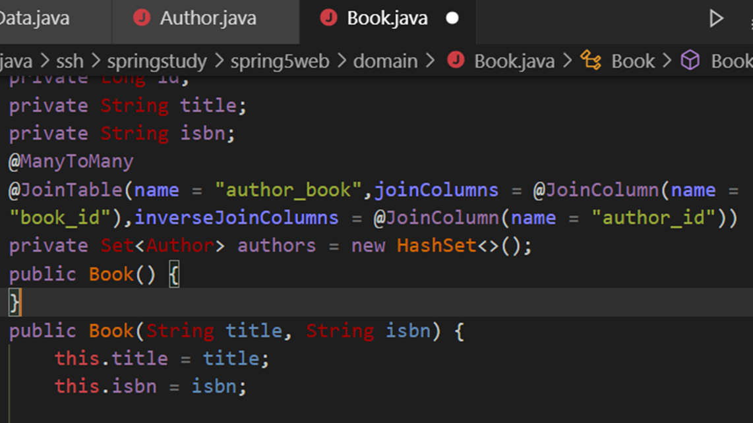
Initializing Data with Spring
Create package named ssh.springstudy.spring5web.bootstrap
Create class named BootstrapData.java , implements CommandLineRunner under ssh.springstudy.spring5web.bootstrap
Added @Component annotation above class
Declare BookRepository and AuthorRepository in BootstrapData.java class
Create Getter/Setter for these repositories , which can make dependency injection
Create Author obj, Book obj and get by each other and then save to respective repository
Create HashSet<>() in Entity ->BookRepository and AuthorRepository
Result is:

Slide 11
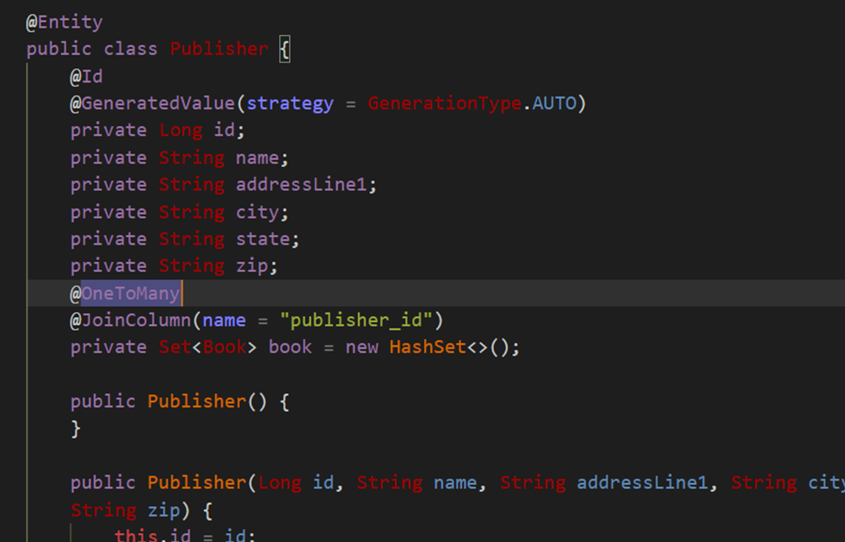
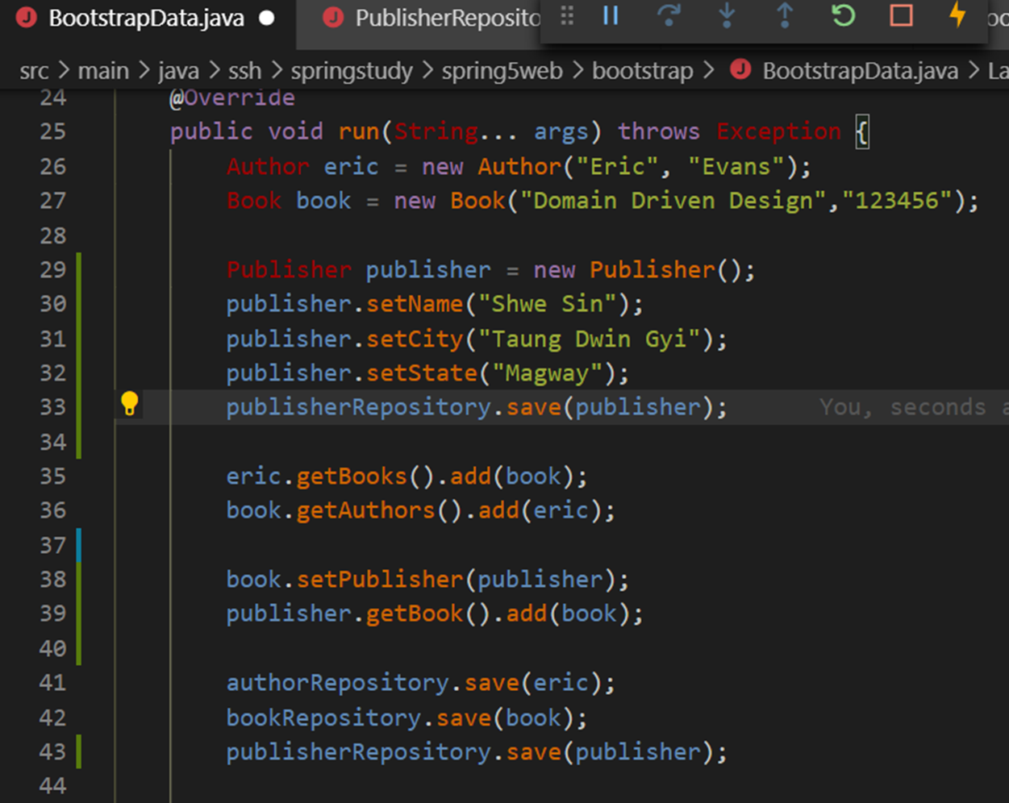
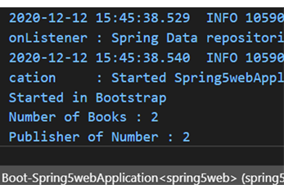
Add Publisher Entity
Create Publisher.java under domain package
Declare Book in Pushisher.java and Getter/Setter for it
@OneToMany
@JoinColumn(name = "publisher_id")
private Set<Book> book = new HashSet<>();
Declare Publisher in Book.java and Getter/Setter for it
@ManyToOne
private Publisher publisher;
Create PublisherRepository under repositories package
Implement Publisher in BootstrapData.java under bootstrap package
Publisher publisher = new Publisher();
publisher.setName("Shwe Sin");
publisher.setCity("Taung Dwin Gyi");
publisher.setState("Magway");
publisherRepository.save(publisher);
Result TEST:
System.out.println("Number of Books : " + bookRepository.count());
System.out.println("Publisher of Number : " + publisher.getBook().size());

Slide 12
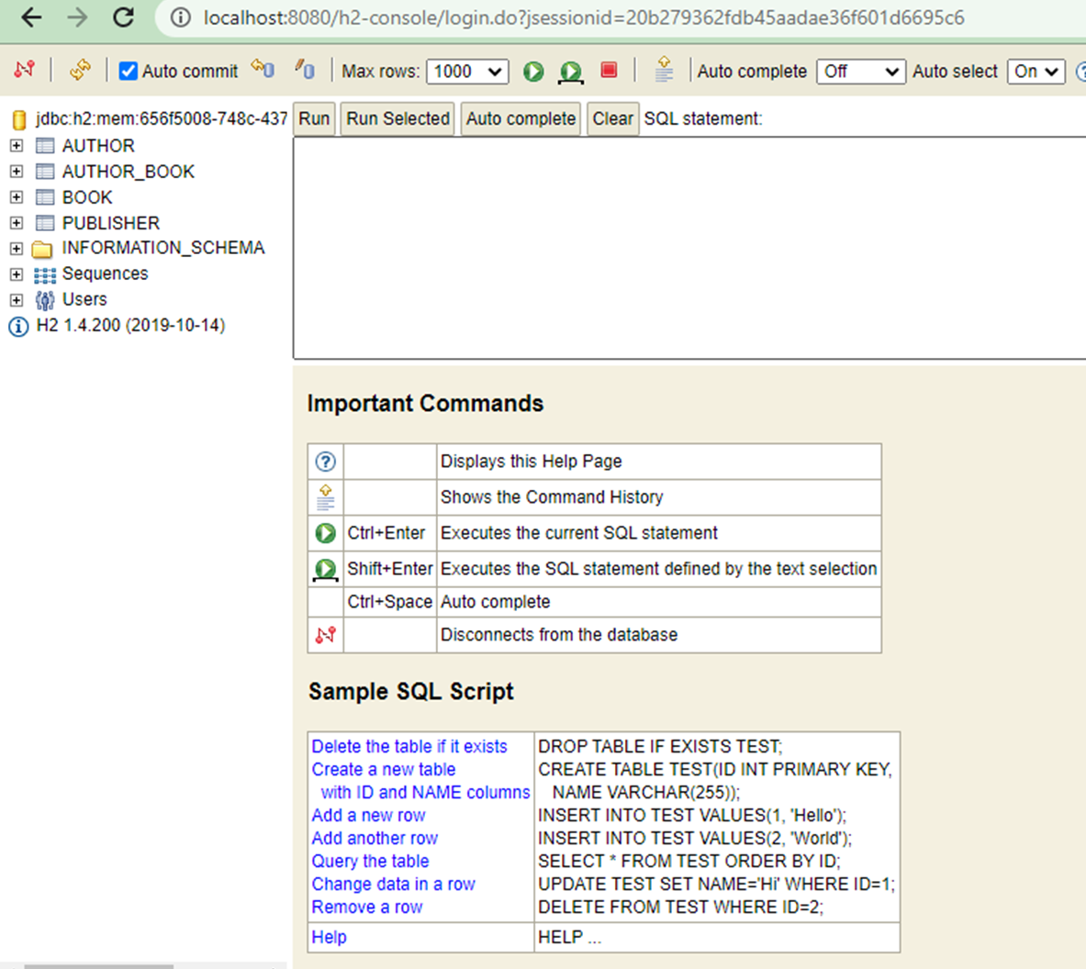
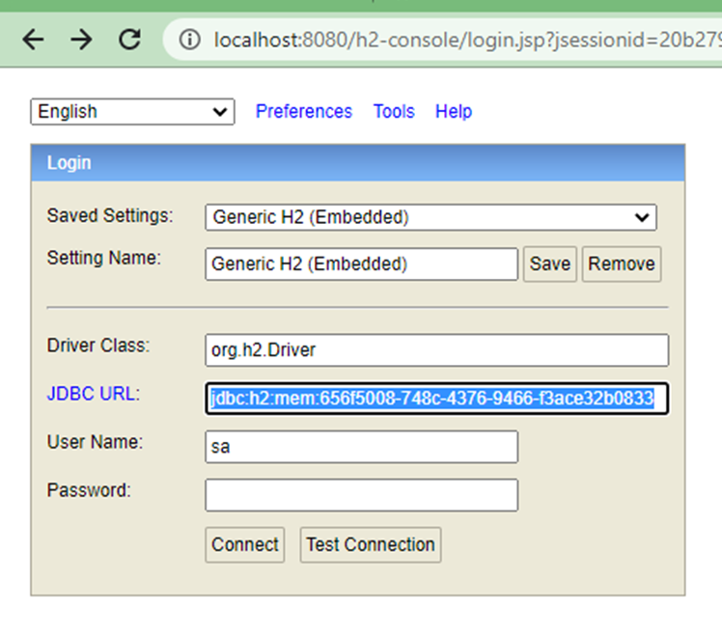
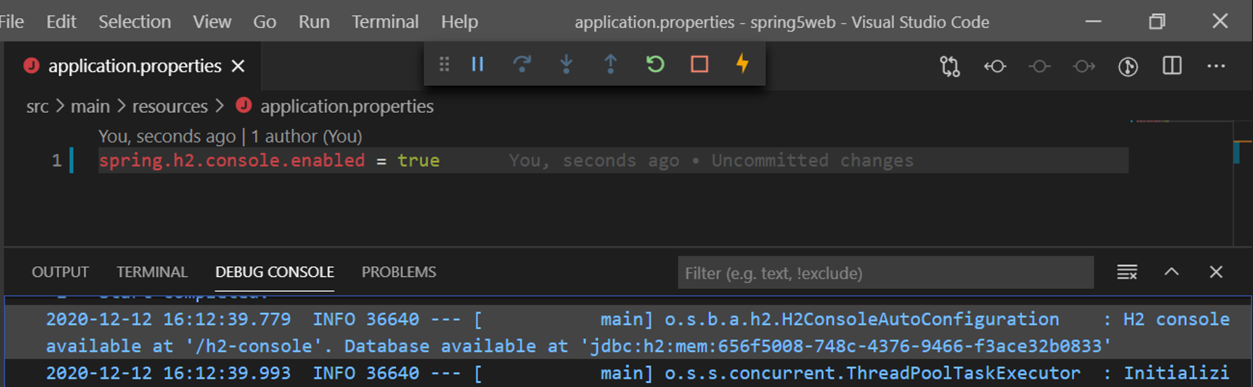
H2 Database Console
application,.properties file added as :
spring.h2.console.enabled = true
Search /h2-console in project console
Type in browser
http://localhost:8080/h2-console
Update JDBC URL as show in project console
Click Connect , your h2 Database reached

Slide 13

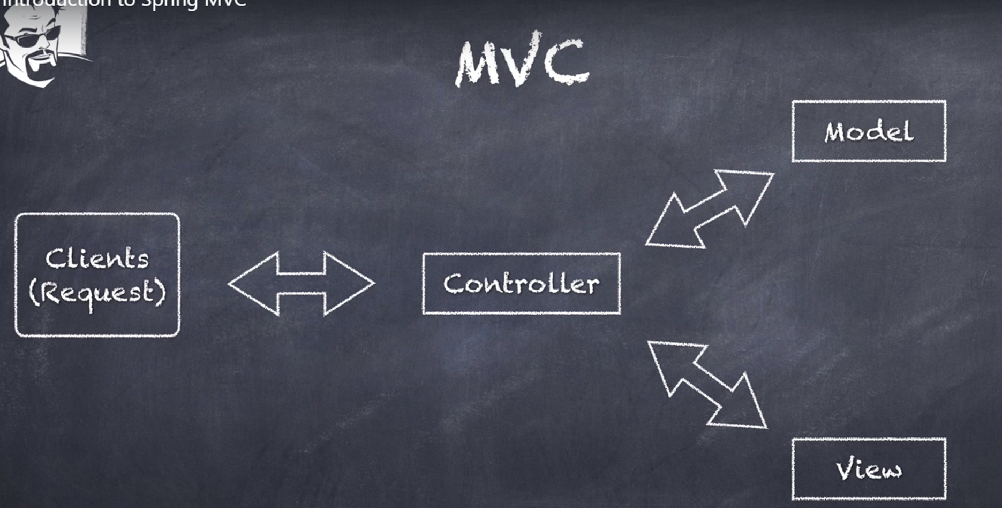
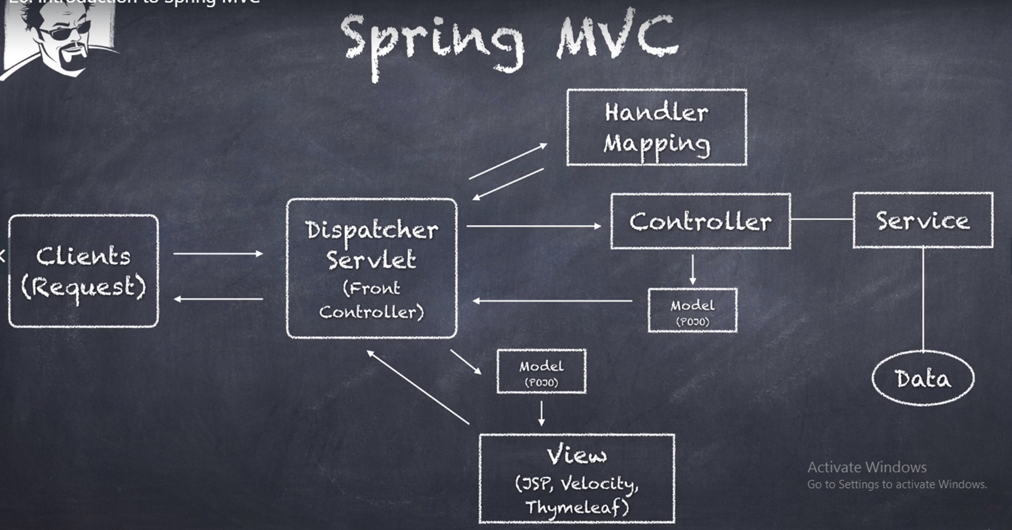
MVC ????

Slide 14
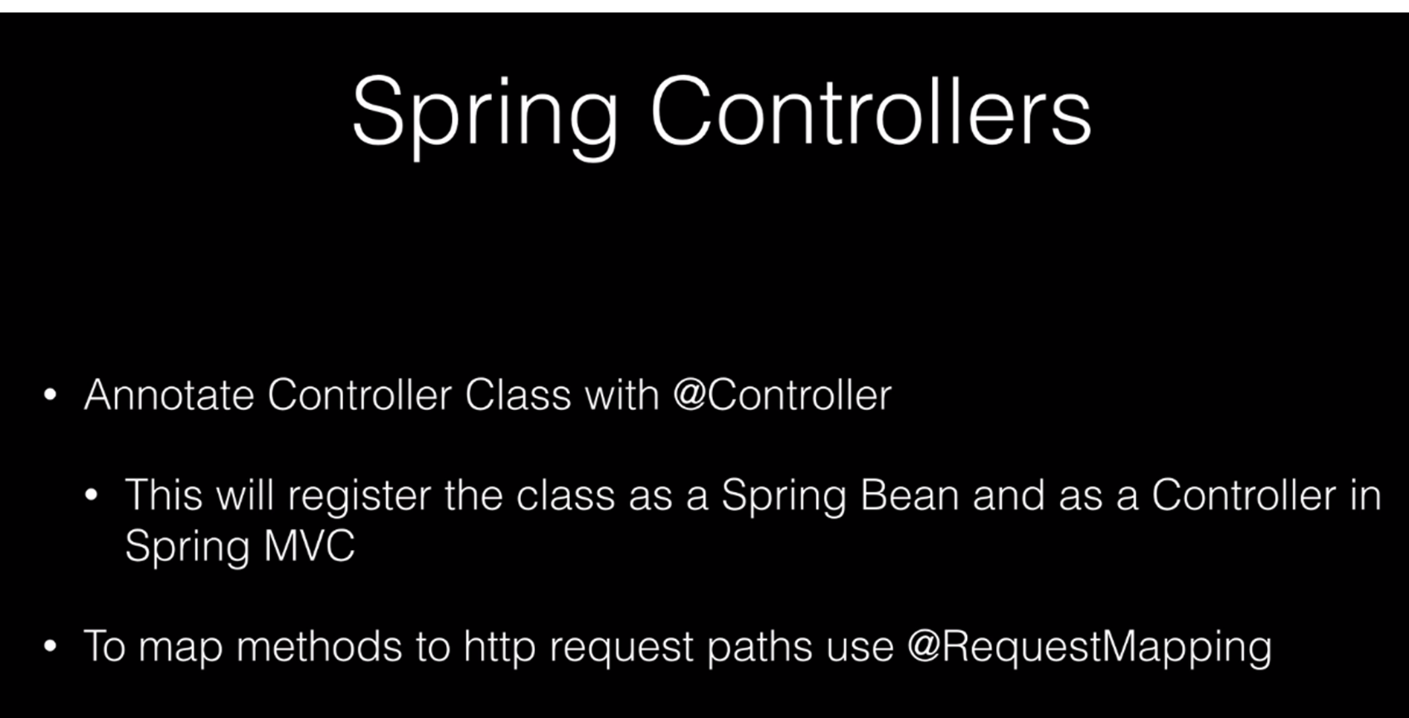
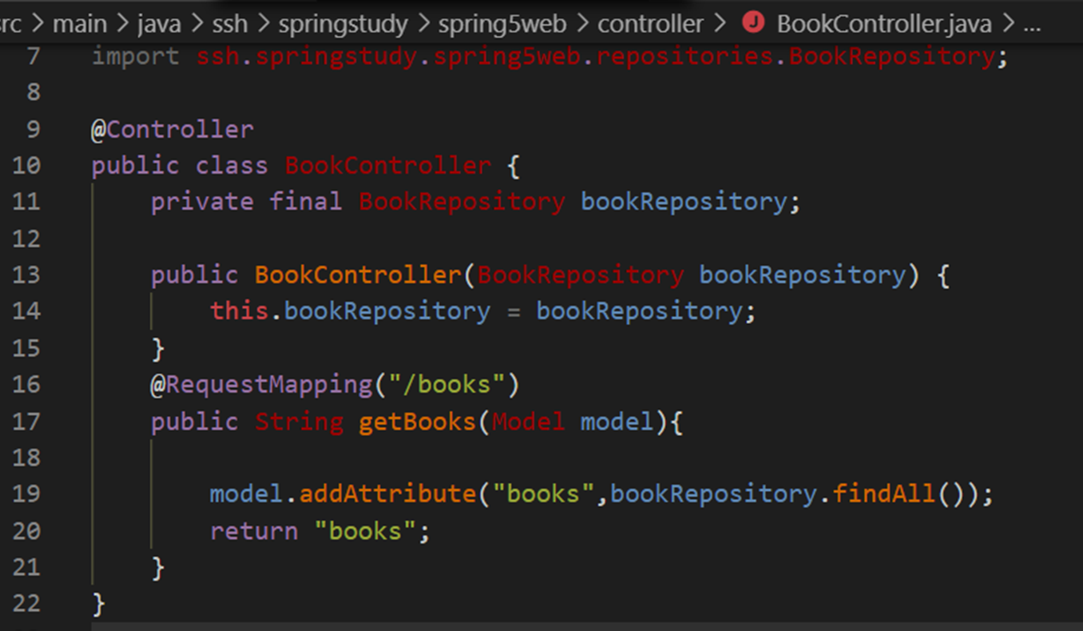
Configuring Spring MVC Controller
Create controller package
Create BookController.java under controller package
@Controller annotation declare above class
Declare book repository and create constructor for it
@RequestMapping(“/books”) declare above method

Slide 15
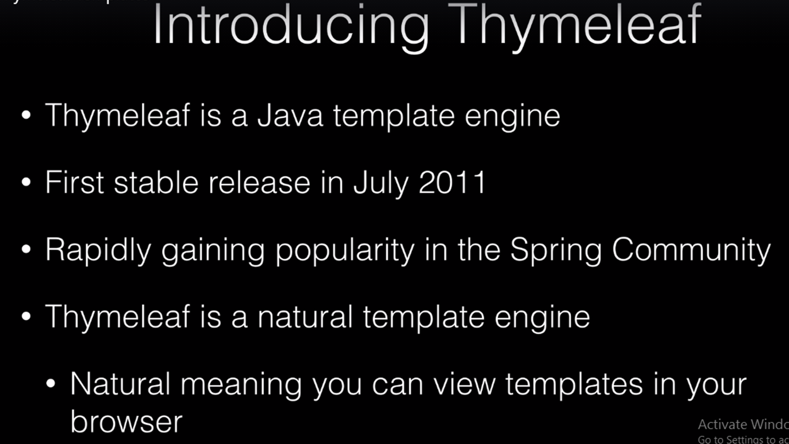
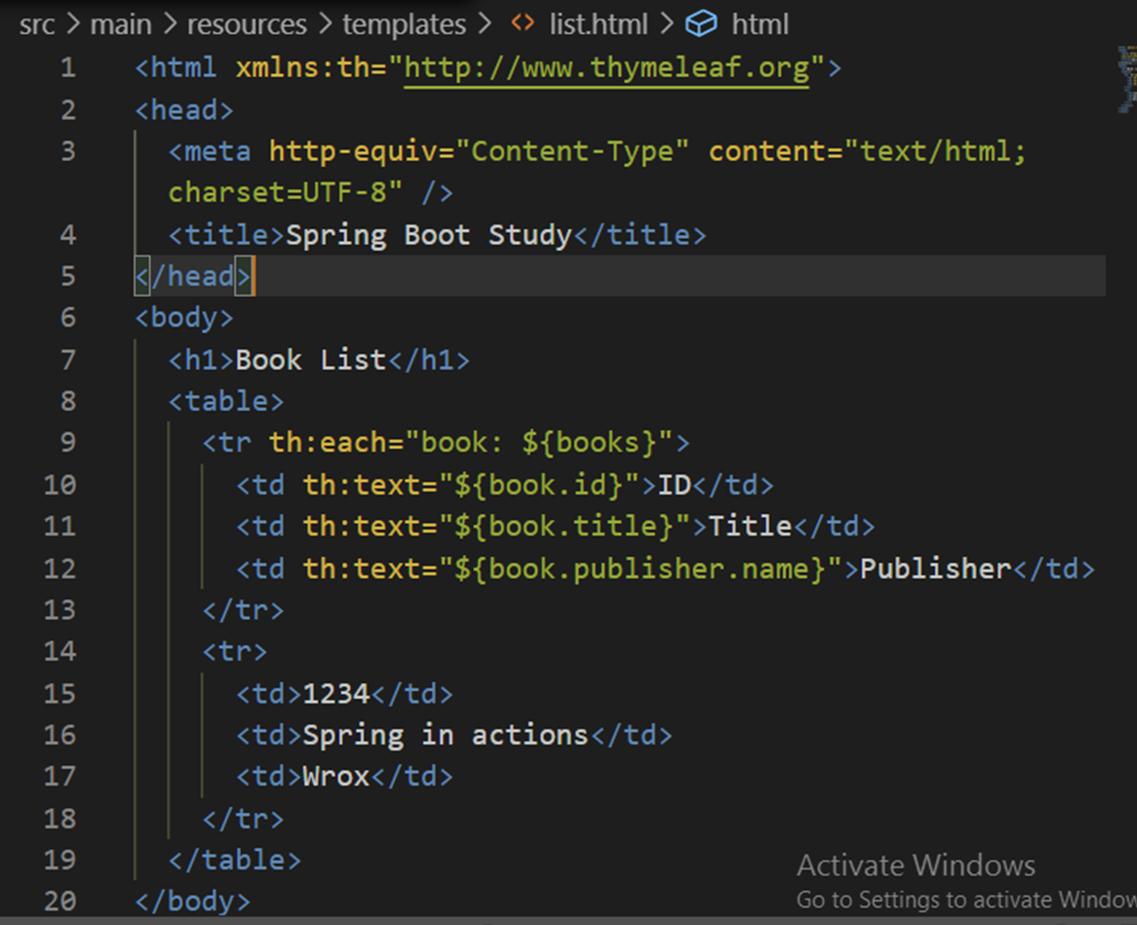
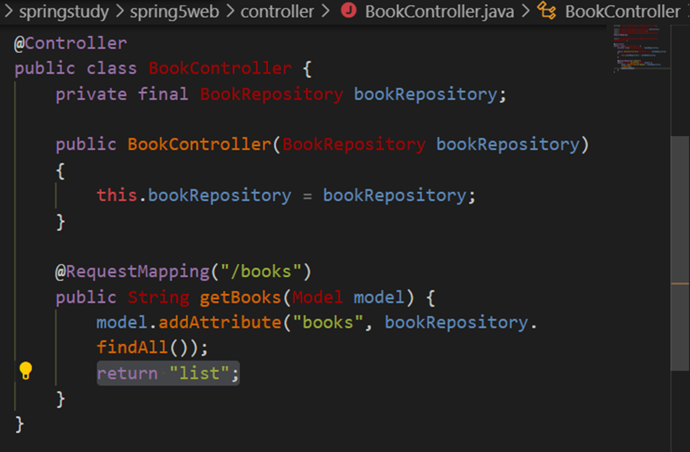
Thymeleaf Templates
Create list.html file under template folder
Write thymeleaf style format in list.html
<html xmlns:th="http://www.thymeleaf.org">
Return html file name in controller

Slide 16
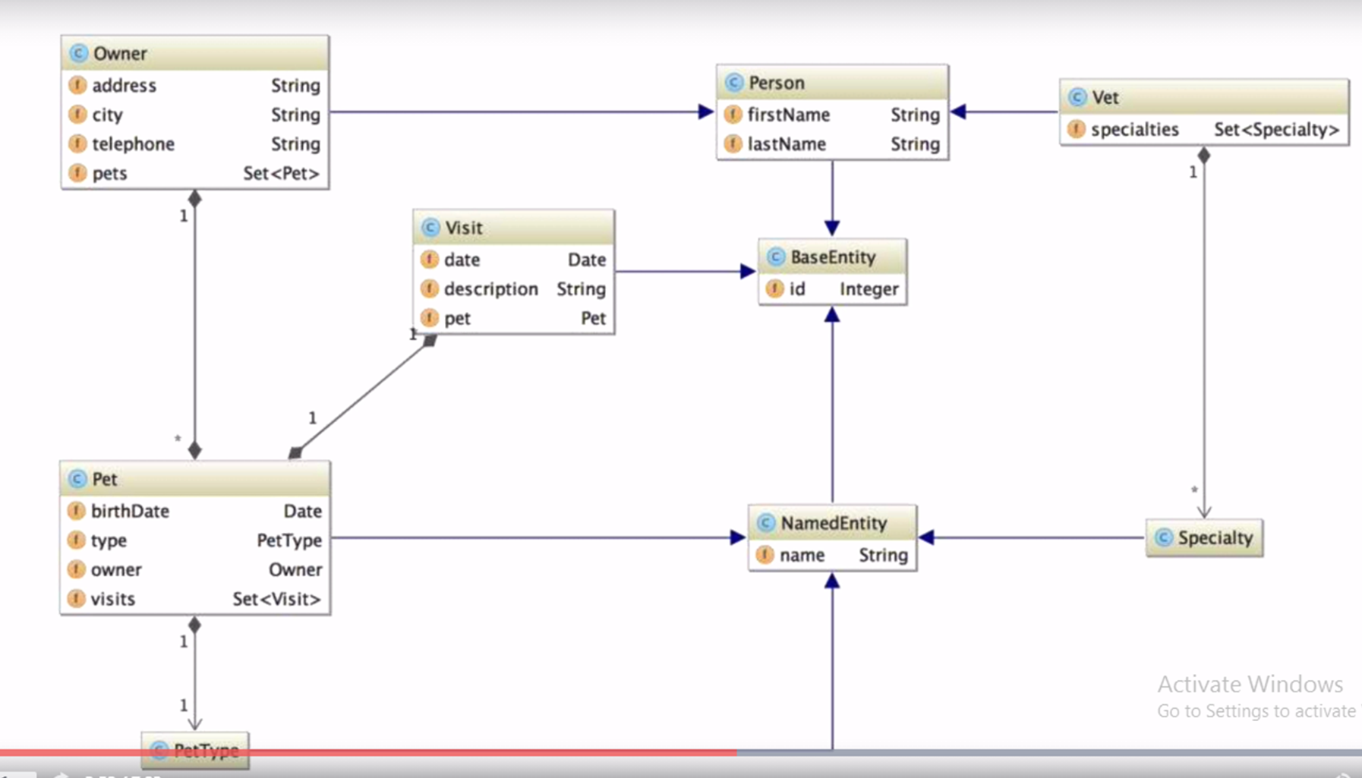
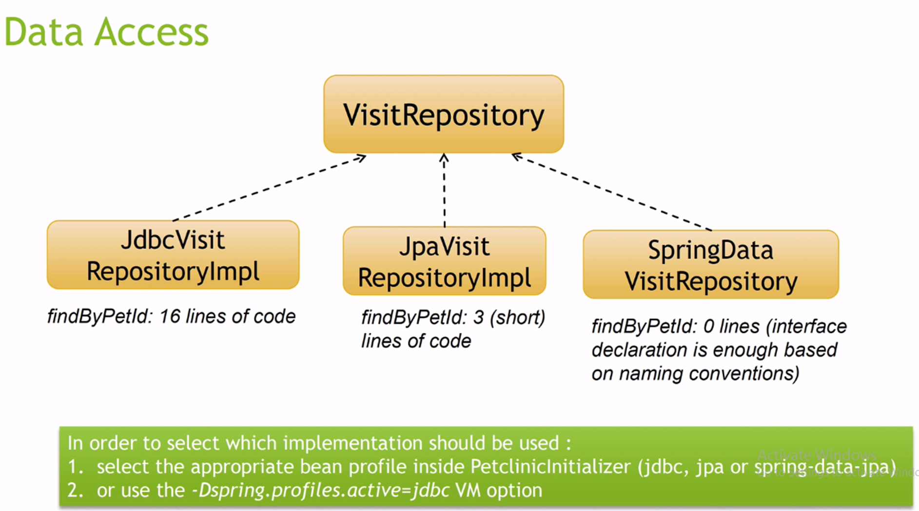
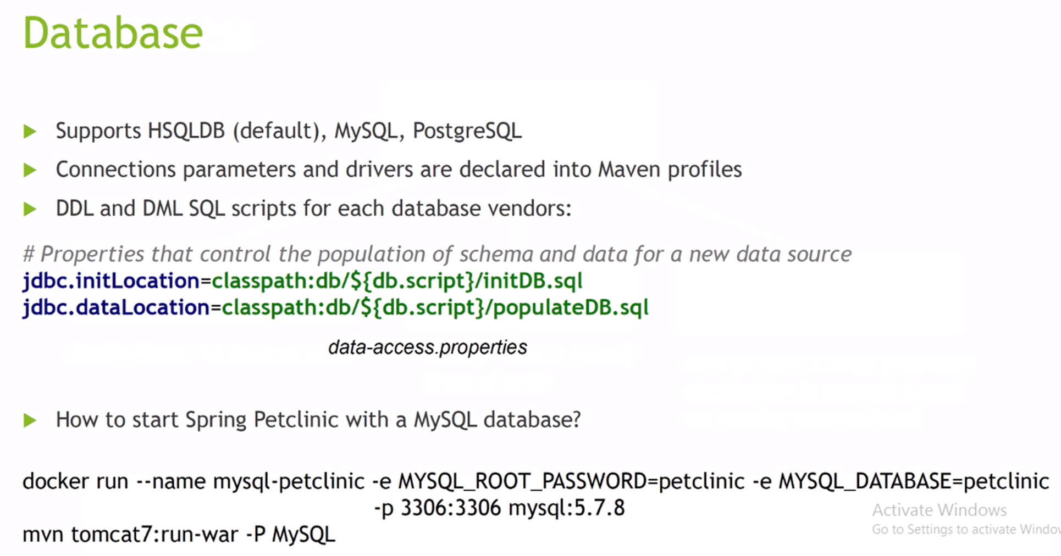
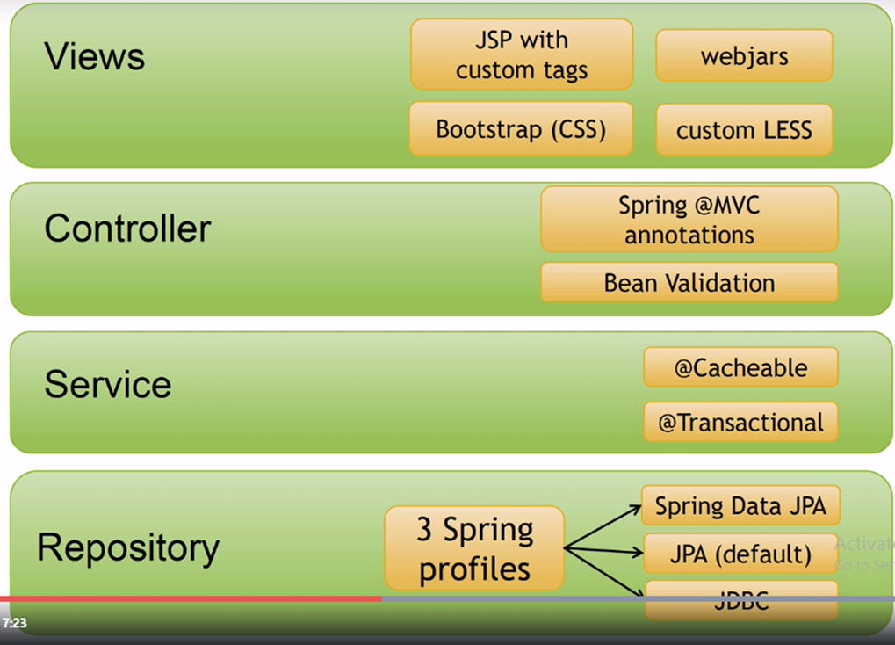
Learn Detail Existing Code Spring Pet Clinic

Slide 17
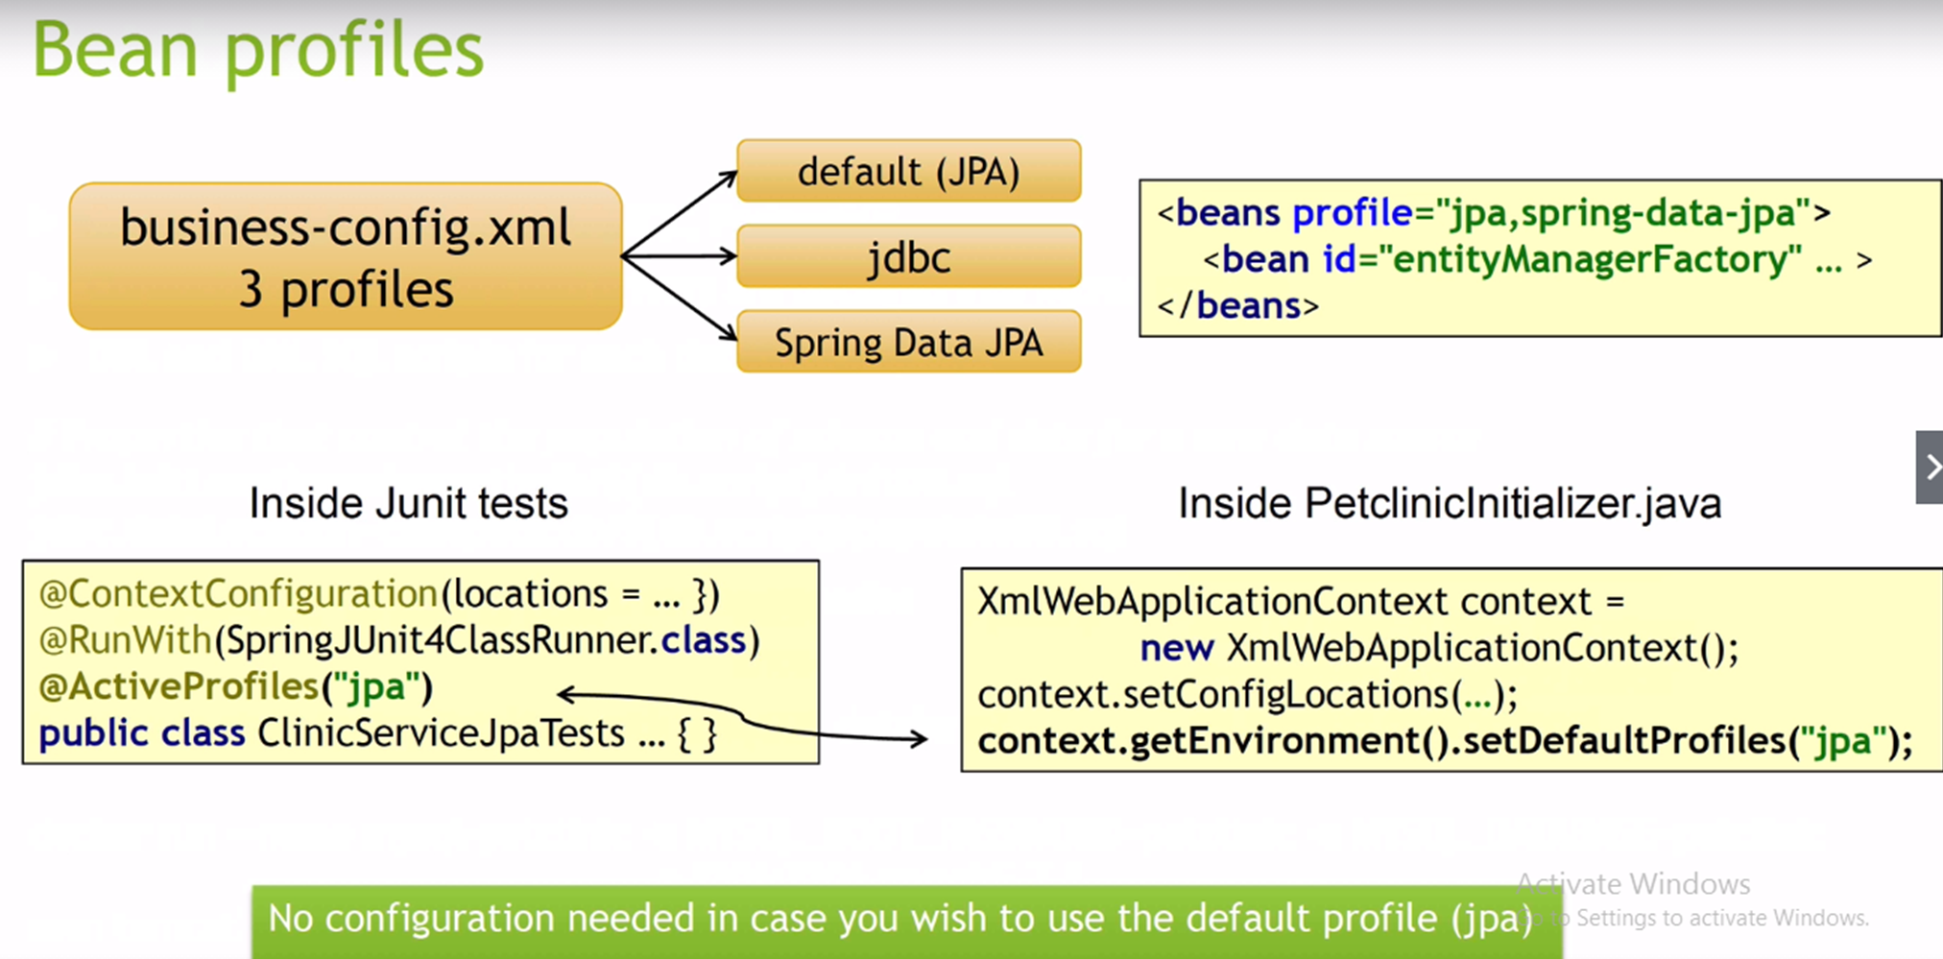
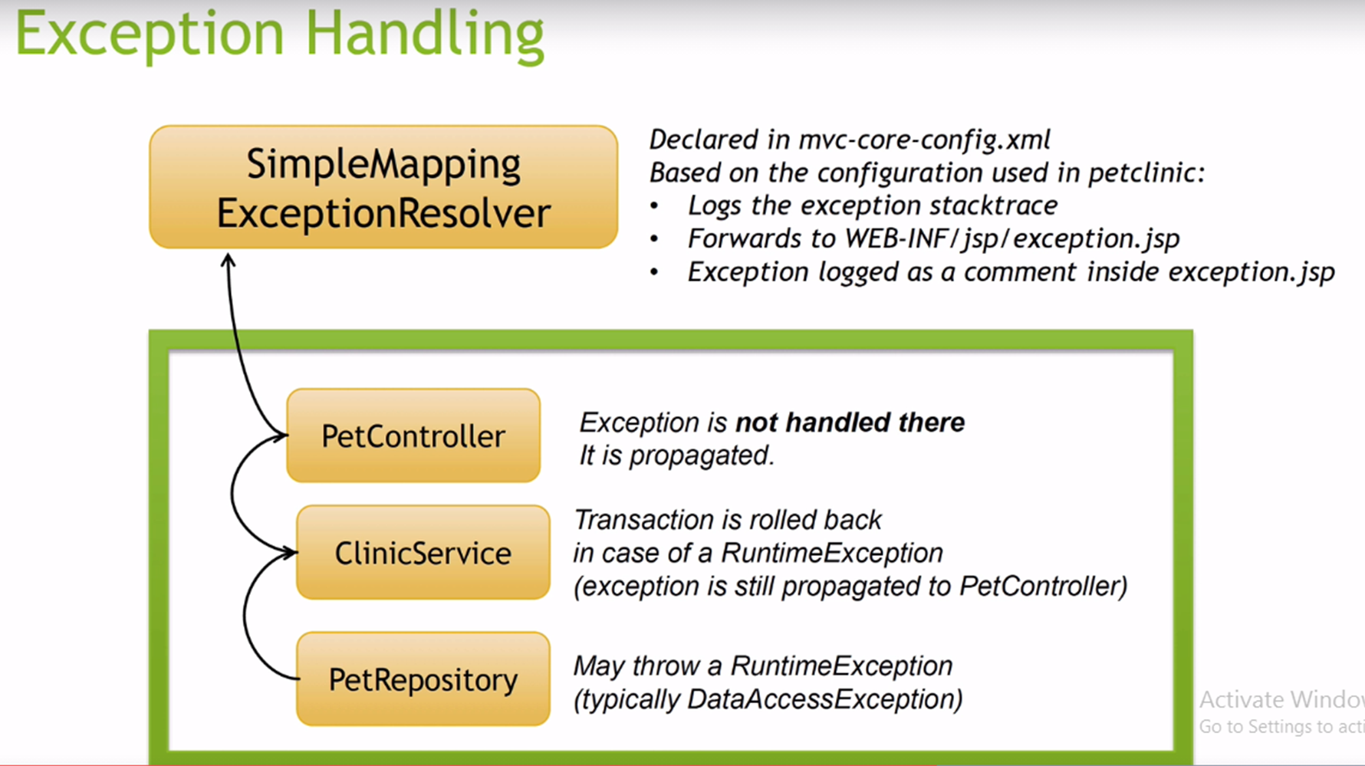
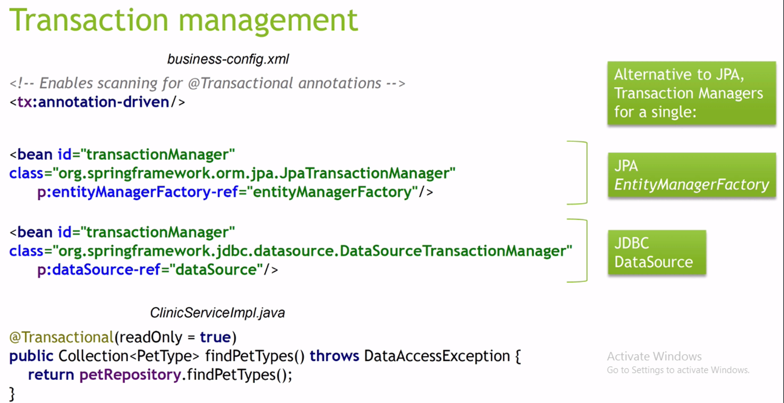
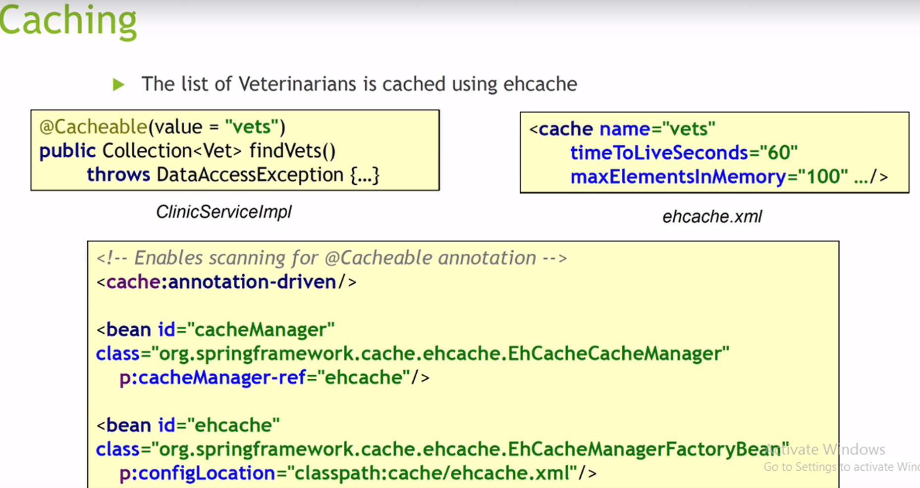
Github Liink : https://github.com/spring-projects/spring-petclinic

Slide 18
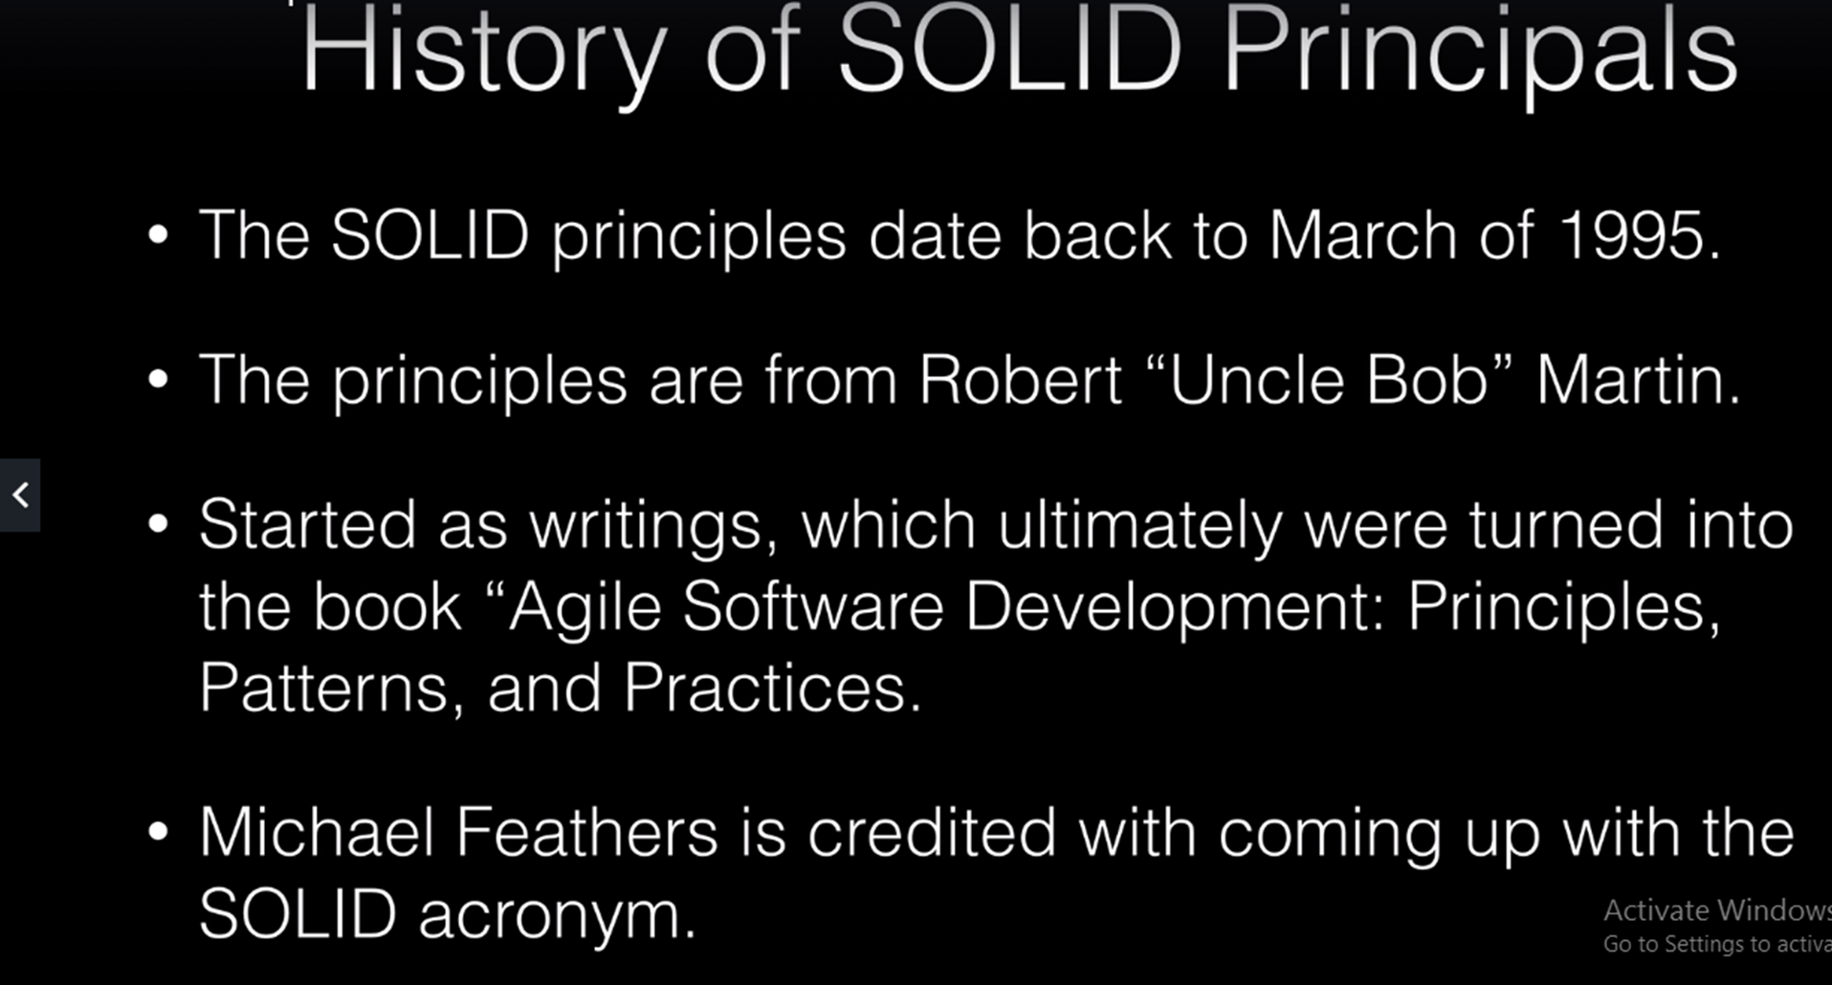

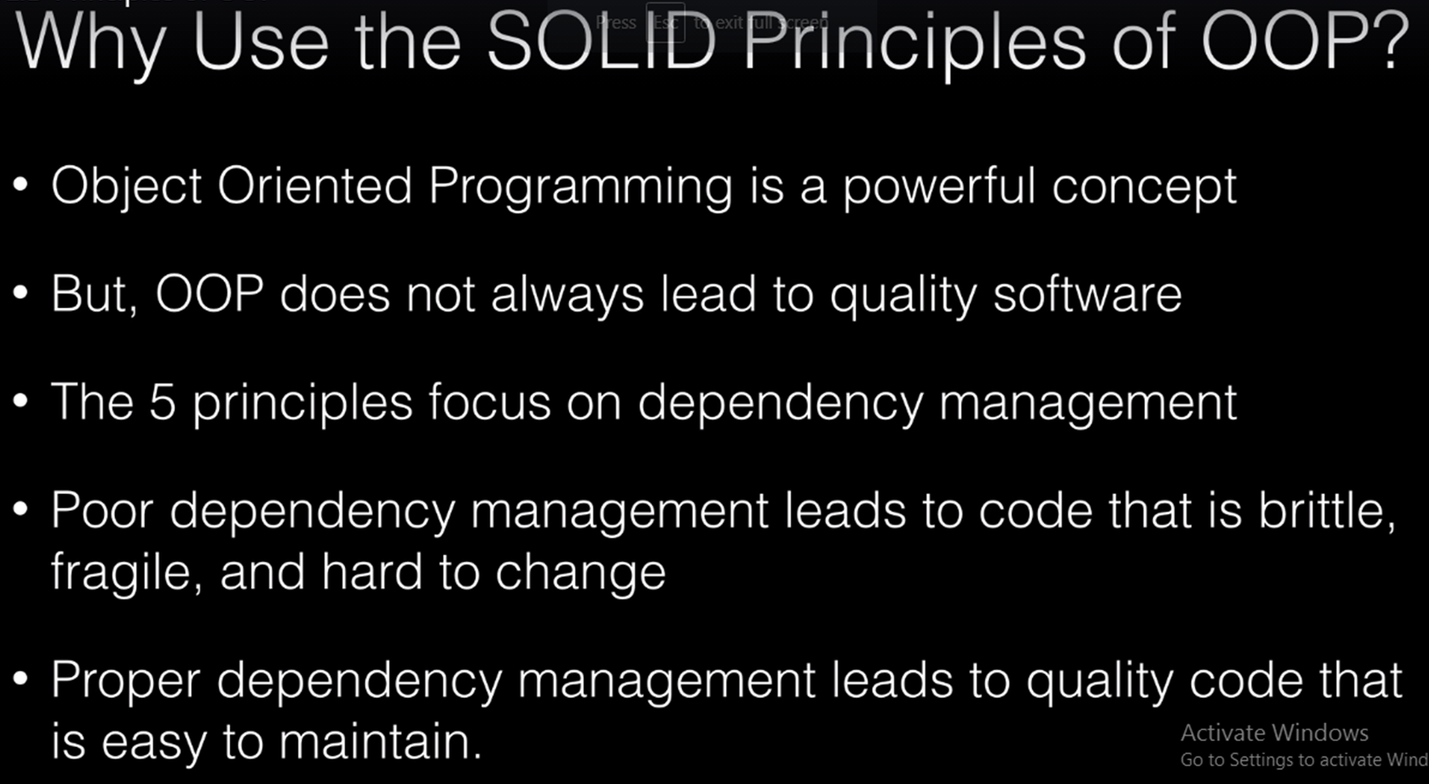
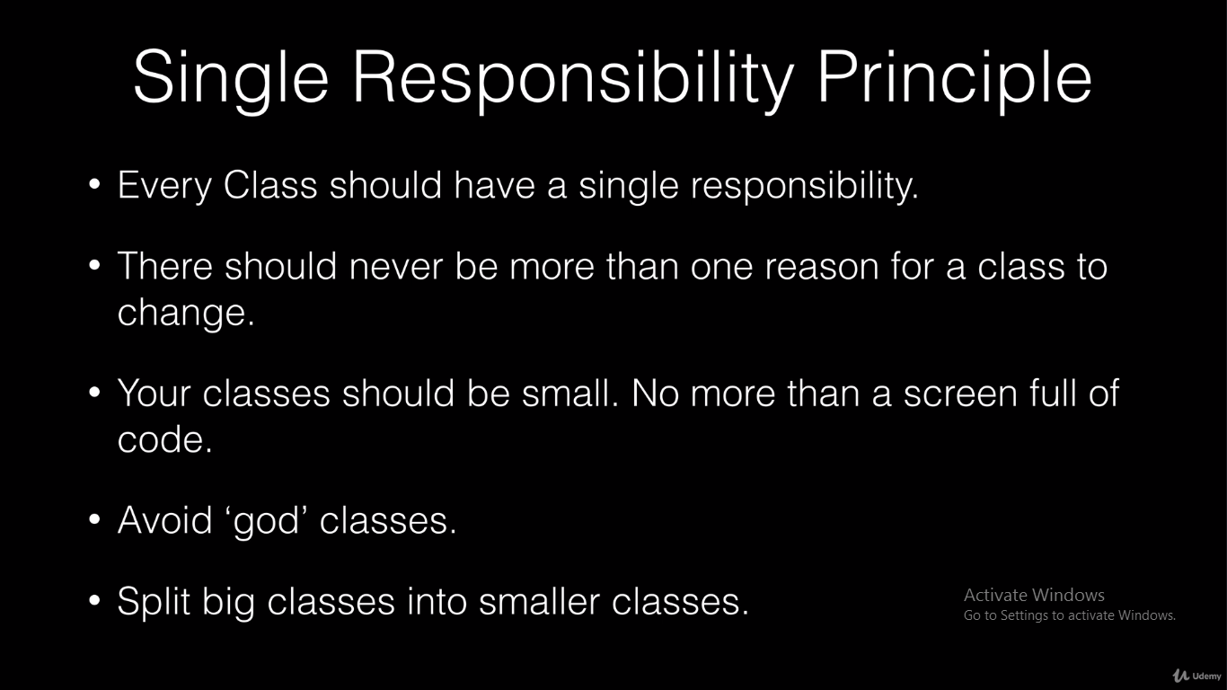
Dependency Injection with Spring
SOLID Principles of OOP
Single Responsibility Principle
Open/Closed Principle
Liskov Substitution Principle
Interface Segmentation Principle
Dependency Inversion Principle

Slide 19
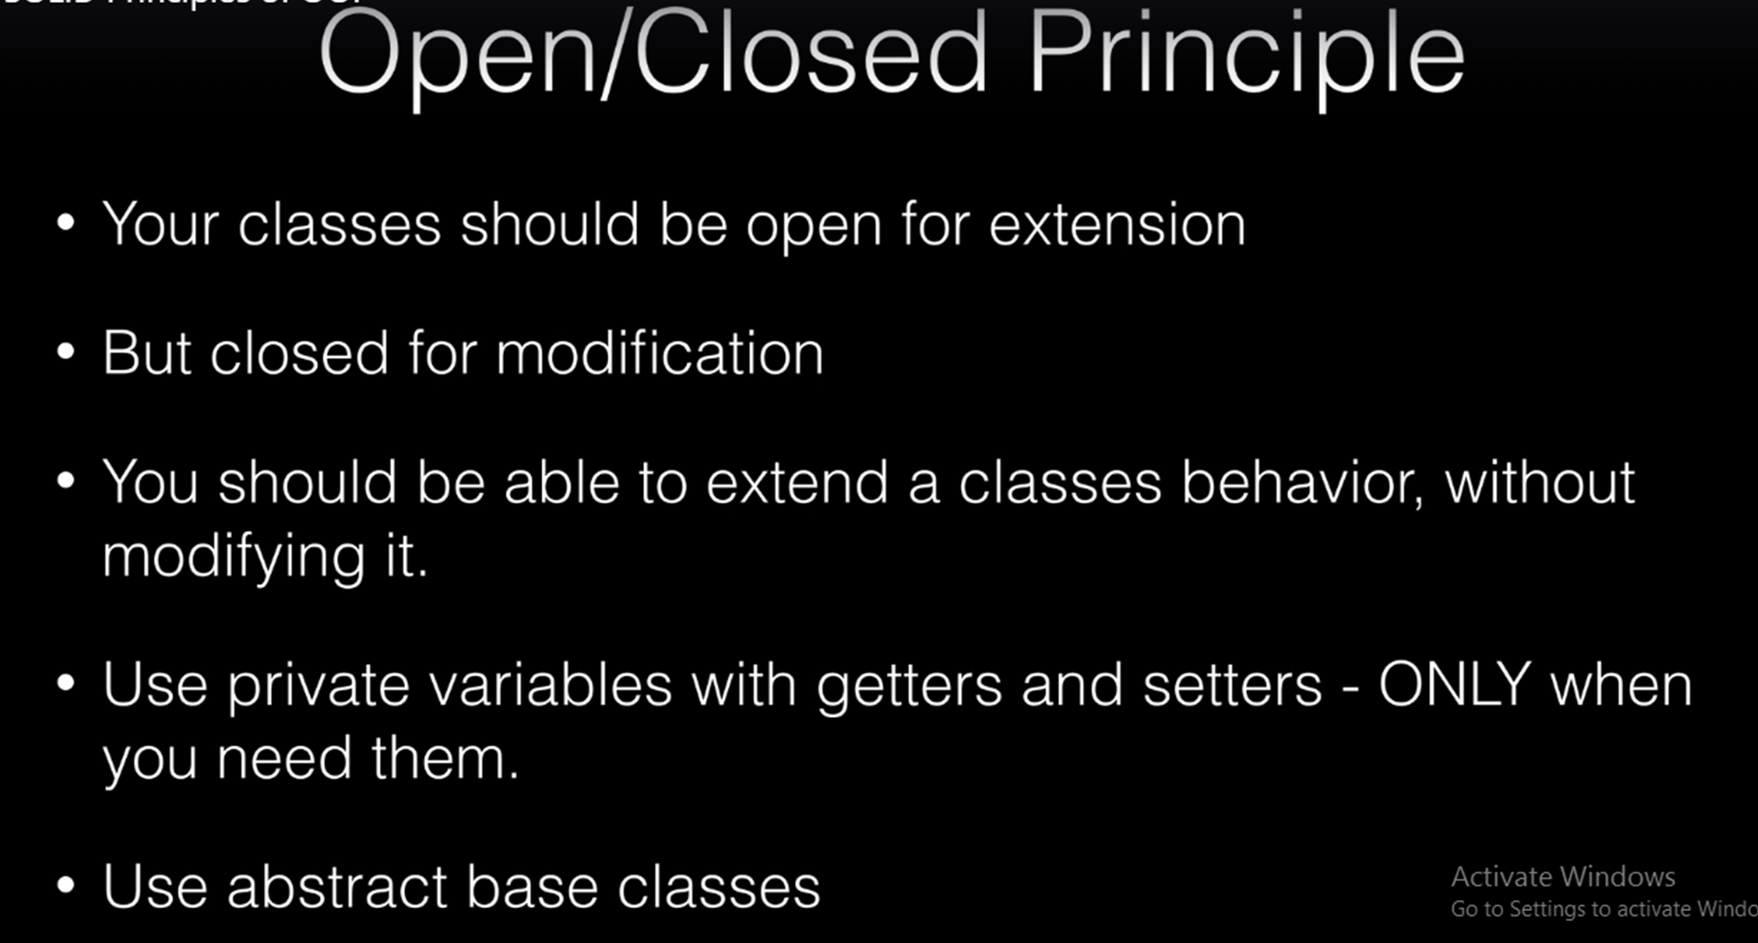

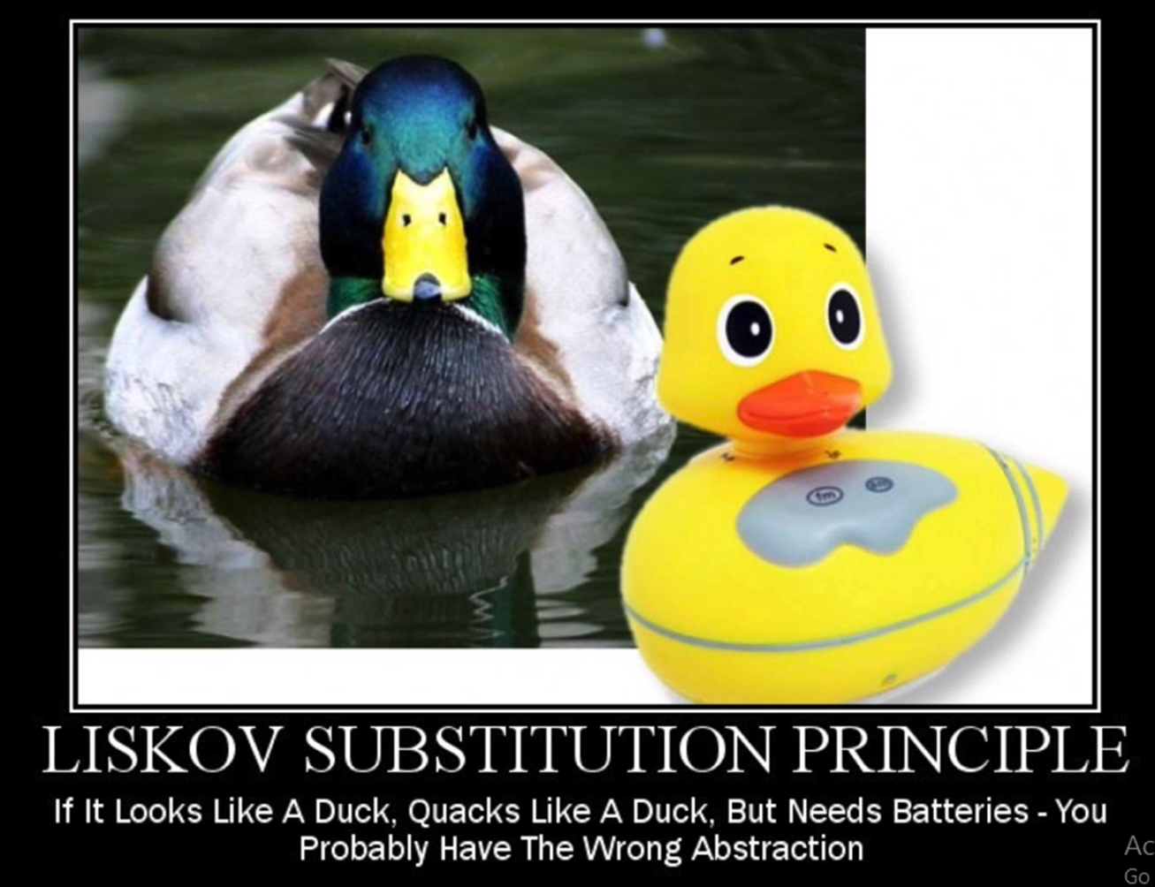
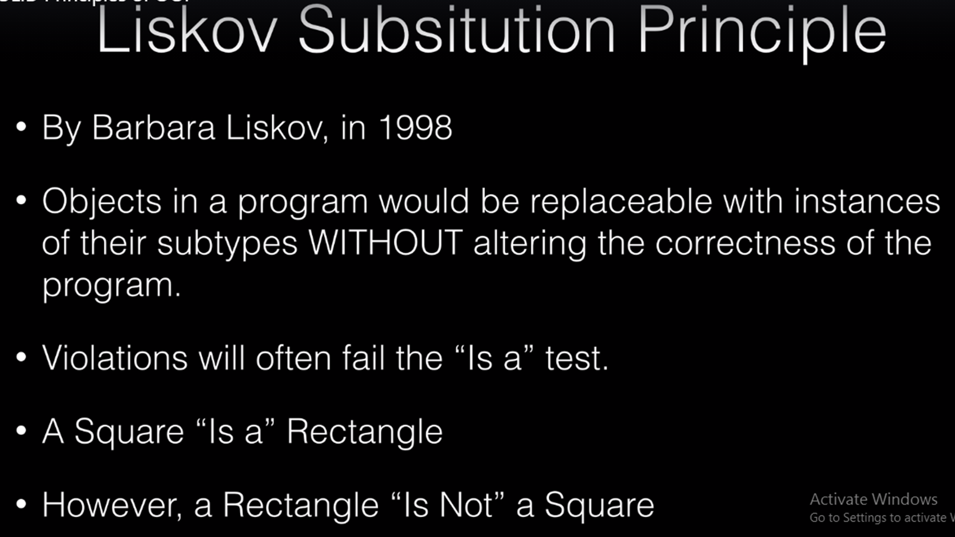

Slide 20
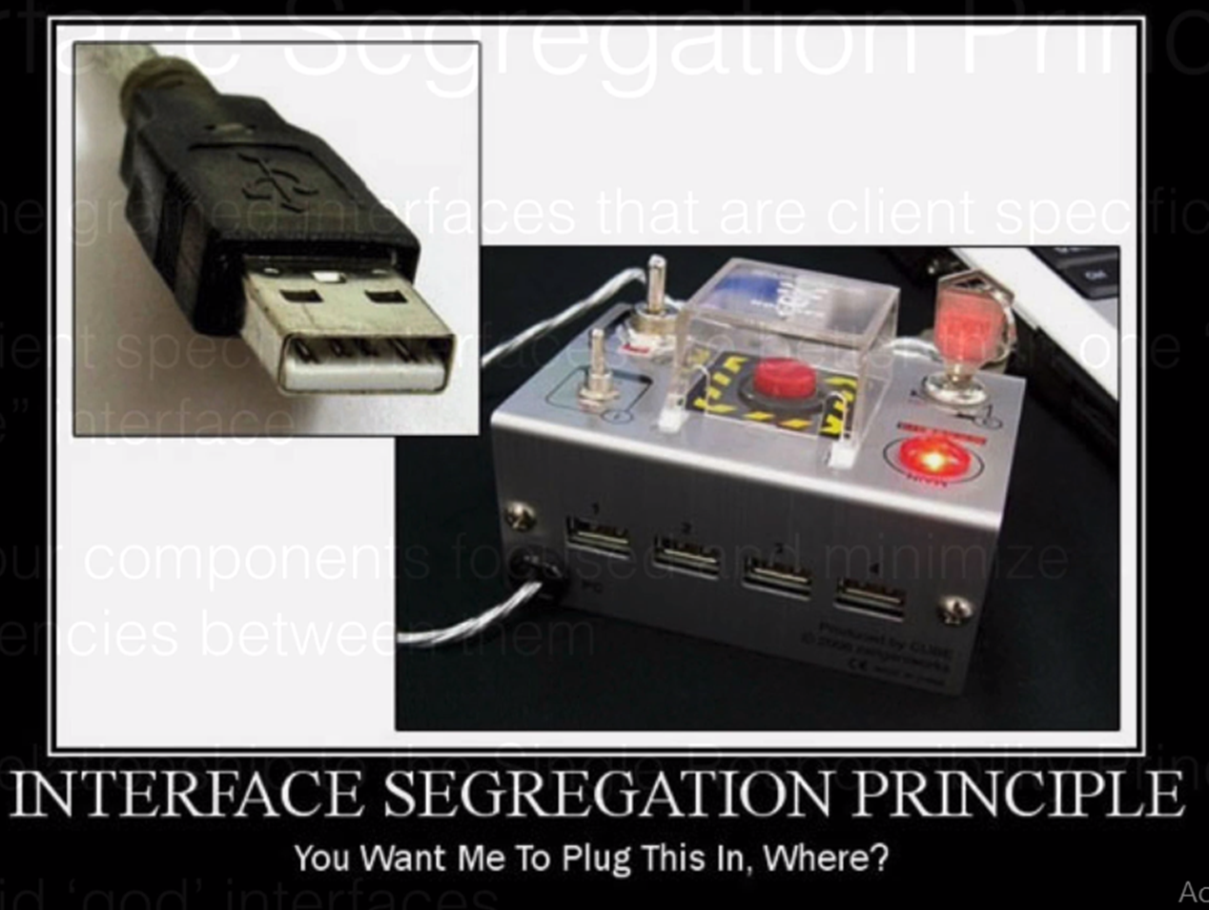
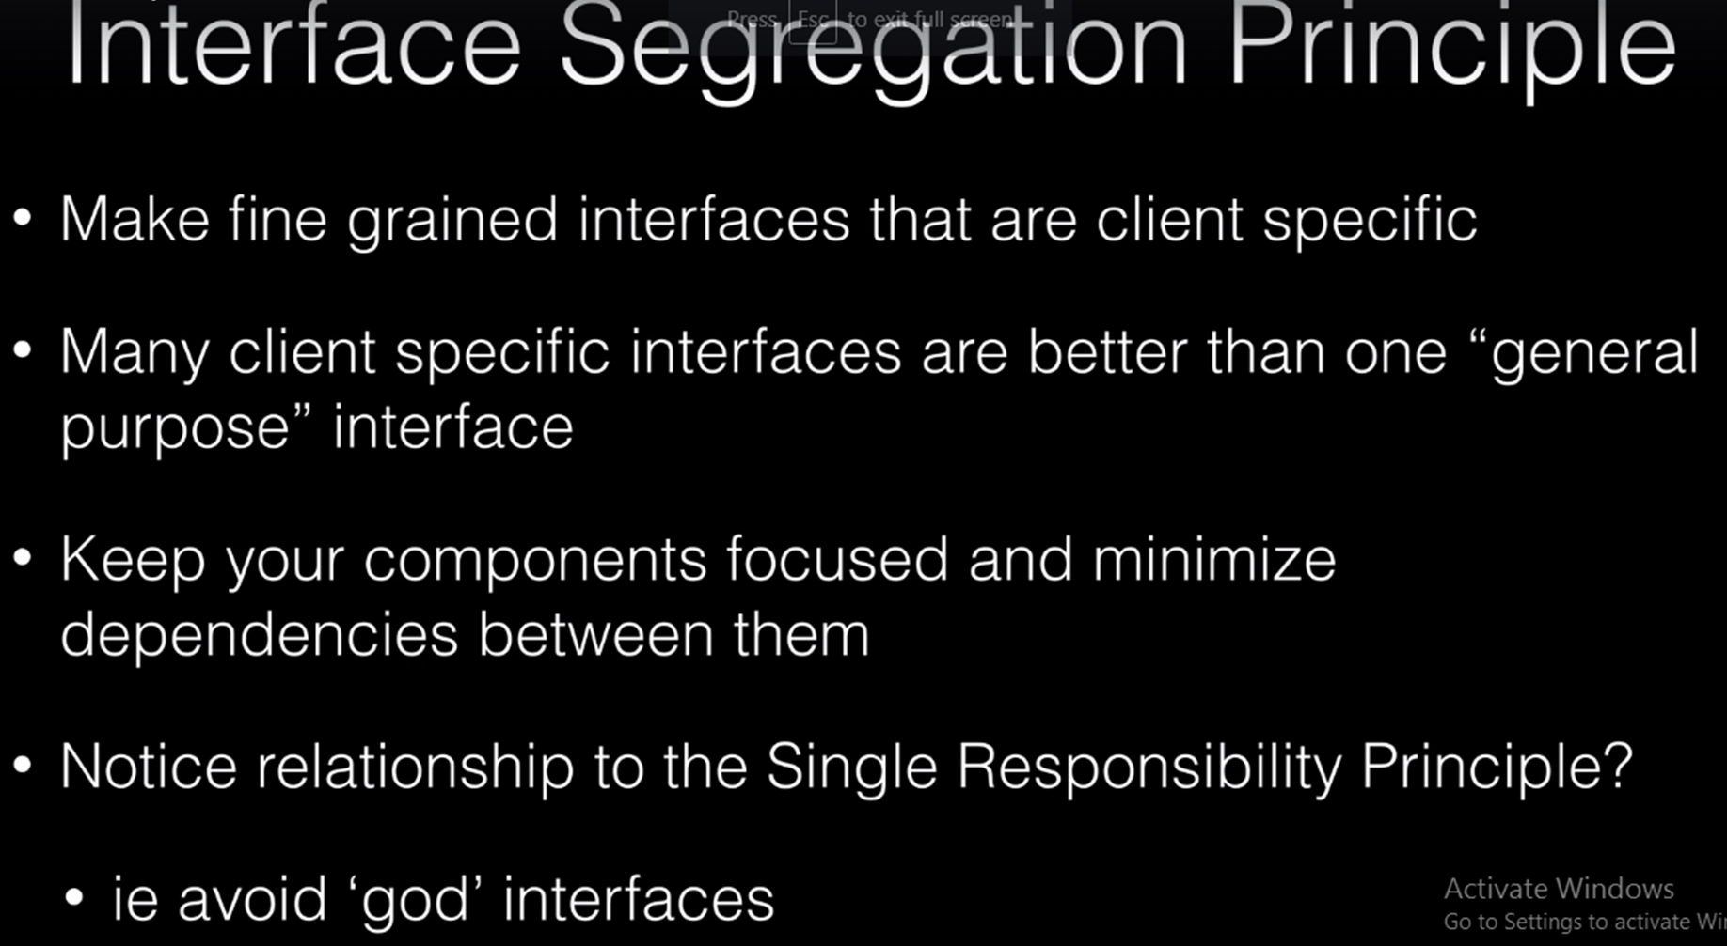
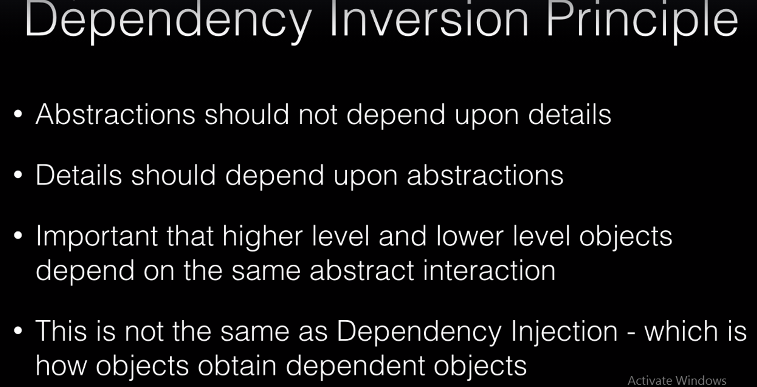


Slide 21
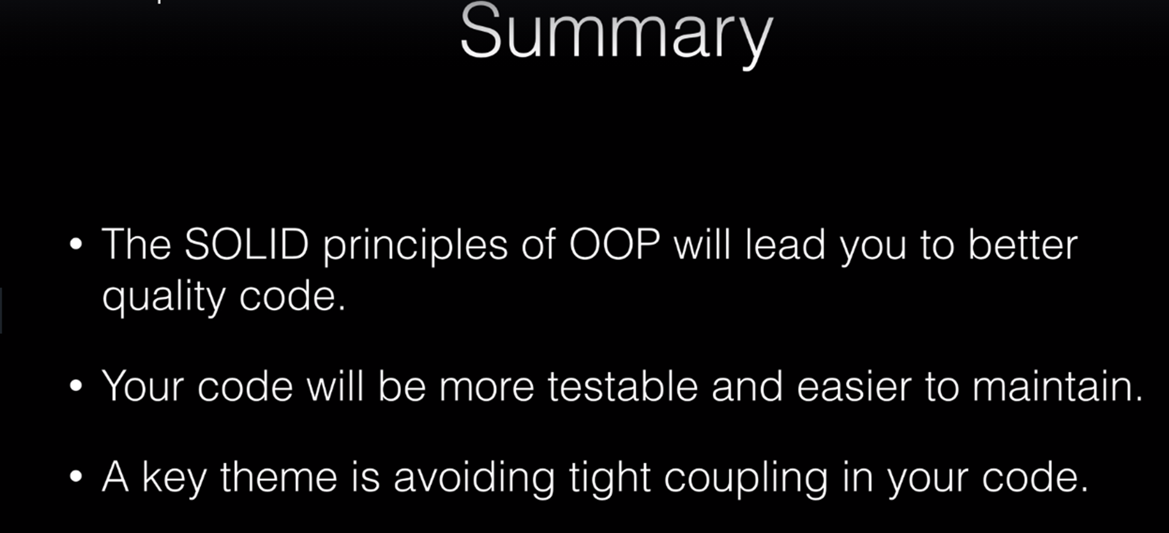

Slide 22



Create Spring Dependency Example Project
Generate Project with no dependency selected by start.spring.io website
Create a package named controllers
Create a class named MyController.java under controllers package

Slide 23





Basic of Dependency Injection

Slide 24



Slide 25


Slide 26

Both Object A and Object B now depends on Interface A, the abstraction.
It inverted the dependency that existed from Object A to Object B into Object B being dependent on the abstraction (Interface A).

Slide 27



Dependency Injection Without Spring
Create a package named service
Create interface named GreetingService under service package
Create a classs named GreetingServiceImp under service package

Slide 28


Dependency Injection Without Spring-Constructor Test

Slide 29


Dependency Injection Without Spring – Setter Test

Slide 30


Dependency Injection Without Spring – Property Test

Slide 31



Dependency Injection With Spring - Property
ConstructorInjectedController and SetterInjectedController is same as this

Slide 32



Using Qualifier
@Qualifier is used when to Specify a bean name you want injected
ConstructorInjectedController and SetterInjectedController
-same as this
Used in Controller @Qualifier(“Service implements Class”) – when same Service interface(GreetingService) is commonly used
Common used Service Interface

Slide 33



Primary Bean
To control no qualifier situation
If you have two bean of the same type, you want to specify a preference for one over the other
Create PrimaryGreetingService
@Primary
@Service
public class PrimaryGreetingService implements GreetingService{ }
Declare GreetingService in MyController class and create constructor for it
private final GreetingService greetingService;

Slide 34





Profile
@Profile(“EN”) – two bean get loaded to the content at runtime
application.properties file, edit as:
spring.profiles.active=ES OR EN
@Service("i18nService") – used in two classes I18nEnglishService and I18nSpanishService, so I18nController need @Qualifier as follows:
public I18nController(@Qualifier("i18nService") GreetingService greetingService) {
this.greetingService = greetingService;
}

Slide 35


Defalut Profile
When application.properties file not configure, default profile will work
@Profile({"EN", "default"})

Slide 36


Spring Bean Life Cycle

Slide 37





Slide 38


Slide 39


Interface Naming Conventions

Slide 40



Spring Boot Jokes App

Slide 41






Steps
Meaven Dependecy copy from as follow link to pom.xml
https://mvnrepository.com/search?q=chuck+norris
Create a package named services
Create JokeService interface
Create JokeServiceImpl class
Create a package named controller
Create JokeController
Create a chucknorris.html

Slide 42


Spring Configuration Options

Slide 43



Spring Framework Stereotypes

Slide 44


Slide 45

Spring Component Scan
Separated many Base Packages
Declare @ComponentScan annotation at main class
@ComponentScan( basePackages = {"ssh.service", "ssh.study.di"})

Slide 46


Java Configuration with @Configuration and @Bean annotation
Create Constructor in service Implement class
Create a package named config and create a configuration class with @Configuration annotation and @Bean annotation
Even though this is a hard class and this is a good situation of where we're using a Java configuration because this class is coming from an external jar and you will use this a lot when you're programming in the Spring Framework when you're dealing with external jar's from an open source project or possibly from another team that you don't control the source code.

Slide 47



Java Configuration with xml file
Create xml file under resource folder chuck-config.xml
Update content in chuck-config.xml file
Update in spring configuration class with xml file configuration
Main sprin class added annotation:
@ImportResource("classpath:chuck-config.xml")

Slide 48



Slide 49





Slide 50



